Slide 1
Data Analytics with Python
Trainer: Michael Li
Venue: NTUC Learning Hub
Date Conducted: 23 Oct 2018

Slide 2
Outline
What is Data Analytics
What is Python
Analytics in Industry
About Data
Data Tutorial
Descriptive, Diagnostic, Predictive
Analytics Tutorial

Slide 3

About Your Trainer
Michael Li
Biomedical Engineering Degree, BioInformatics Specialist
Expansive Experience
Biomedical Devices and Diagnostics
Systems Engineering and Server Administration
Analytics Consultancy
Data Scientist
Innumerous strategies to solve Data-Fusion problems Solution Architect
Recommendation Engines
Semantic Technologies
Fraud Analytics
Text Mining
www.linkedin.com/in/michaelqali

Slide 4
Data Analytics with Python
What is Data Analytics

Slide 5
What is Data Analytics
The science of drawing insights from raw information sources
Also commonly known as Data Mining, Data Science,
Has multiple branches:
Big Data
Text Mining
Business Analytics
Machine Learning
Quantitative Analytics

Slide 6
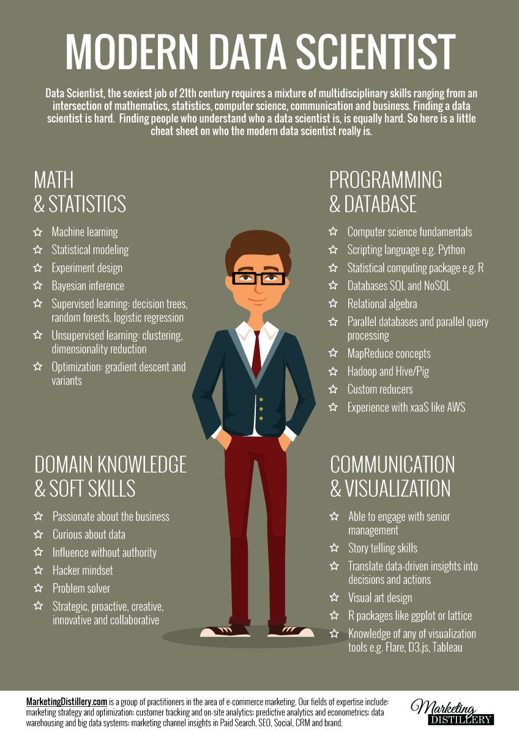
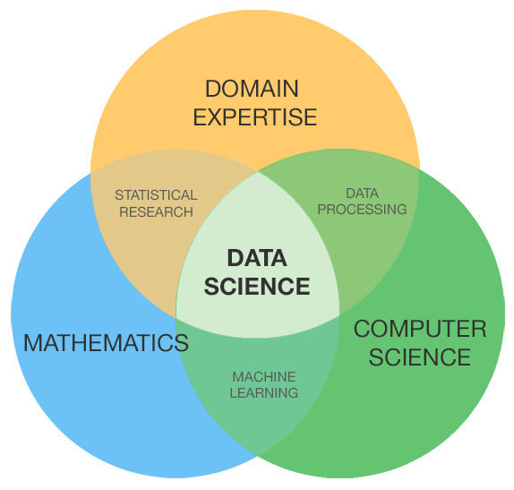
What is Data Analytics

Slide 7
Data Analytics Skills
Main Skills Category | Why | Examples
Business and Communication | Understand and extract Business Goals, Key Performance Indicators, Problem Statements. Define, formulate and deliver actionable targeted analyses. | CRISP-DM
Visualization and User Interface | Create easily digestible, usable dashboards and interactive charts. | Business Intelligence (Tableau, QlikSense) Visualization Libraries (D3.js, bokeh)
Statistics | Pick out significant factors from data. Find outliers in data points. Understand the quality of the data provided. Quantify the accuracy or applicability of tests done. | Chi-square, Standard Deviation, Pearson Correlation
Software Engineering | Data Management e.g. Extract-Transform-Load. Automation of Data Processing and Preparation. | Programming skils (Java, Python, R, C/C++/C#, Hadoop)
Machine Learning | Assess feasibility of running Predictive Modelling on data. Choosing the right model for the dataset. Tuning parameters used in the model. | Clustering (Meanshift, K-means, etc.), Classification (RandomForest, Naïve bayes, etc.), Active Learning, Deep Learning
Science & Engineering | Formulate an analysis approach to a problem. Identify and apply measurable performance indicators on method used. Apply best practices and standard procedures for different domains. | AB-testing, Scientific Method, Standards/Body-Of-Knowledge
Social Skills | Keep in touch with current technology trends and techniques. Maintain network of contacts from various domains. | Knowledge Sharing between other Professionals, Confidence and Humility

Slide 8

Methodology
Cross-Industry Standard Process for Data mining (CRISP-DM)
CRISP-DM is a very general approach and widely used in analytics projects.
Due to the highly varied nature of data from
different entities, the length of an Analytics
project may range from 1 week to 1 year
(excluding deployment).
Thus, it is now a recommended practice to
conduct a small-scale feasibility study first.
6 Phases of CRISP-DM

Slide 9
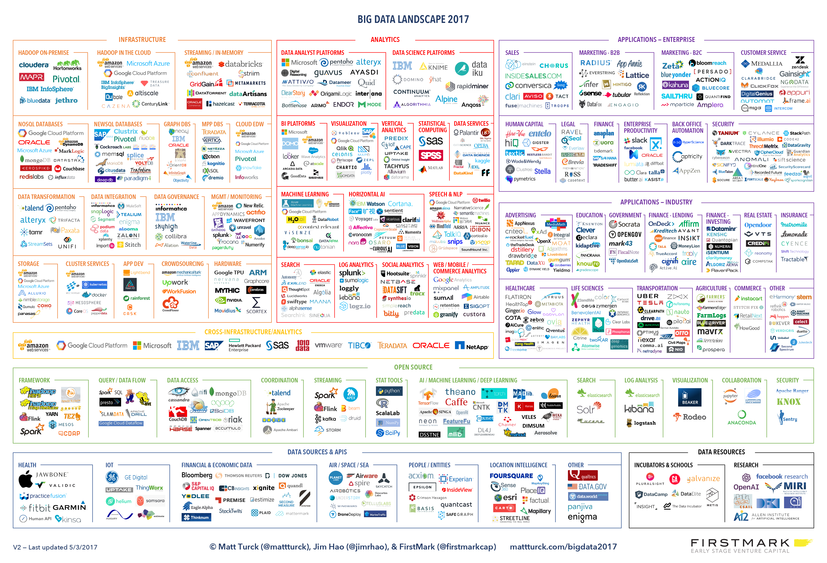
Enterprise Tools
With increasing awareness of the value of data and analytics; Many Enterprise Analytics Solutions have been appearing in the market.
However, no solution can be fool-proof. Continual education and knowledge sharing amongst peers is essential to improving one’s ability to extract insight.

Slide 10
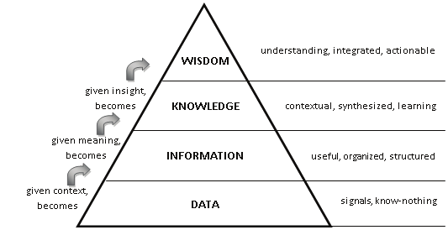
From Data to Insights
Action
Increasingly summarized
DIKW Pyramid

Slide 11
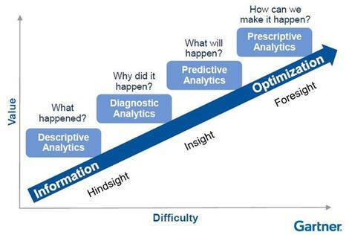
Outcomes from Analytics
Modeling
Statistics and Correlation
Business Intelligence

Slide 12
Data Analytics with Python
What is Python?

Slide 13
What is Python?
Official Definition:
Python is an interpreted, object-oriented, high-level programming language with dynamic semantics. Its high-level built in data structures, combined with dynamic typing and dynamic binding, make it very attractive for Rapid Application Development, as well as for use as a scripting or glue language to connect existing components together. Python's simple, easy to learn syntax emphasizes readability and therefore reduces the cost of program maintenance. Python supports modules and packages, which encourages program modularity and code reuse. The Python interpreter and the extensive standard library are available in source or binary form without charge for all major platforms, and can be freely distributed

Slide 14
Why/Why Not Python?
Why:
Community Support is very good
Documentation of Libraries are mostly good
Many libraries (especially the data science ones) are computationally efficient!
Syntax is easier to read and use than most other languages
It can do many things!
Why not:
Some people think its still a simple scripting language and not an Enterprise ready language
Library not built yet
It can do many things!

Slide 15
Data Science Libraries
Library | Why | Remarks
IPython Notebook | Provide a data science notebook to run scripts and and in line documentation. | Essential.
NumPy | Computationally efficient numerical calculation/storage package. Included here just for kudos to the developer. | Learn-as-you-go
SciPy | Computationally efficient matrix calculation/storage package. Included here just for kudos to the developer. | Learn-as-you-go
Pandas | Data Frames in R was really cool. Python now has it too! | Essential. Very good project to follow, as each new version includes commonly used functions by scientists!
Scikit-learn | Machine Learning Library | Well documented with examples. Default parameters are already the at recommended settings.
Sklearn_pandas | Bridge between pandas and sklearn | Allows for some convenient mapping of table columns to feature matrices used by the sklearn package.
statsmodels | Another Machine Learning Library | Not as commonly used as sklearn but some examples online still uses this.
nltk | Natural Language Toolkit for Computational Linguistics | For text analysis that requires parsing the structure of the sentences

Slide 16
The Pandas Library
The pandas library is a Data Frame library (inspired from R) with a collection of data manipulation packages.
It is deemed essential in any Data Scientist’s toolbox due to the ease of running descriptive analyses (like R Data Frames) and data manipulation.
The manipulation operations are computationally efficient as the “batteries” behind it are NumPy and SciPy.

Slide 17
The SKLEARN Library (SciKit-Learn)
The Scikit-learn library contains a wide collection of machine learning algorithms with extensive documentation on each family of algorithms and examples of the usage of each algorithm.
See the user guide http://scikit-learn.org/stable/user_guide.html

Slide 18
Please check that you have a working copy of Python on your machine
https://www.anaconda.com/download for those that have not yet installed Python on their system.
There are slight differences between Python 2 and Python 3
For our exercises; we will be using Python 3.
Those using Python 2 may want to set up an environment with Python 3 using https://conda.io/docs/user-guide/tasks/manage-python.html
Otherwise, there will be a few lines of code that need to be changed e.g. print statements

Slide 19
Data Analytics in Python
Data Analytics in Industry

Slide 20
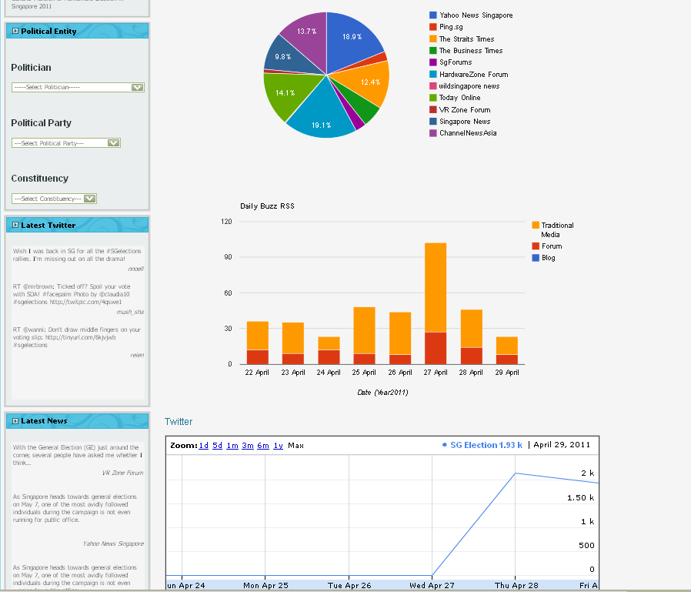
Social Media Analytics
Social Media Analytics is about tapping into different social media channels, and summarizing them into a coherent picture for the user.
Involves:
Campaign Tracking
Brand Tracking
Sentiment Analysis
Social Media Sensing

Slide 21
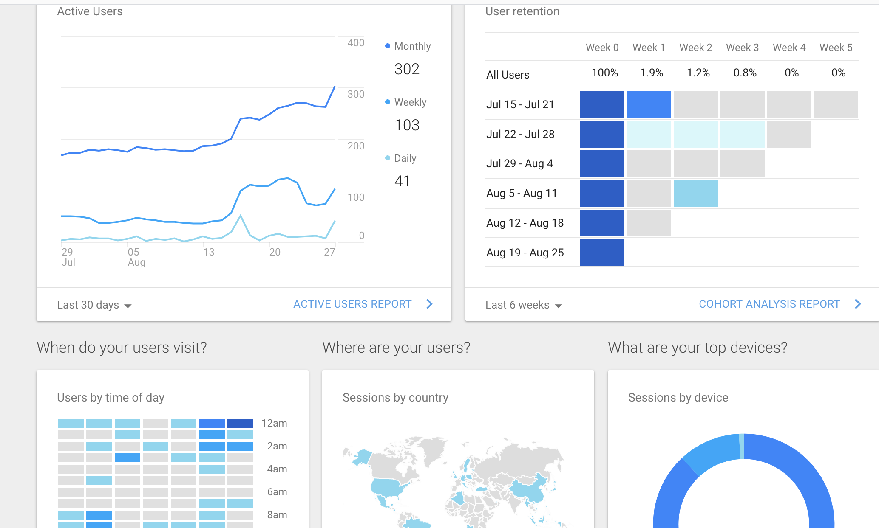
Web Analytics
Web Analytics is the collection and summarization of web data to your website. The insights are mainly used to track traffic and can be used in conjunction with search engine marketing (SEM)
Involves:
Site Traffic Monitoring
User Profiling
Click Analytics
Google Analytics (Web Tracking)

Slide 22
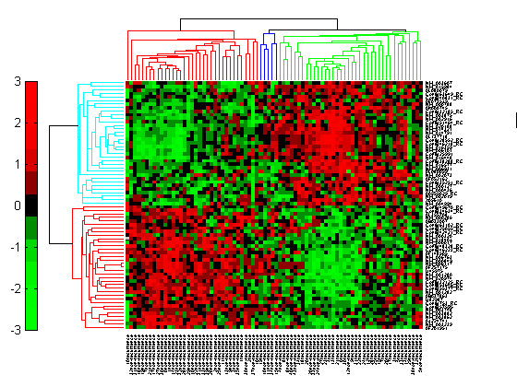
Medical Analytics
Medical Analytics is the application of computer science and statistical analyses to biomedical data. Medical data spurred the rise of Big Data strategies through optimization of algorithms.
Involves:
BioInformatics
Clinical Informatics
Data Fusion
Microarray Heatmap

Slide 23
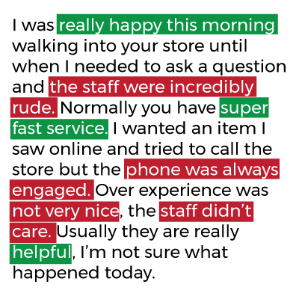
Text Analytics
Text Analytics can be domain by itself due to the complexity involved in working with text data. The majority of effort is in the information extraction from documents.
Involves:
Document Clustering
Sentiment Analyses
Natural Language Processing (Linguistics)
Named Entity Recognition
Text Extraction

Slide 24
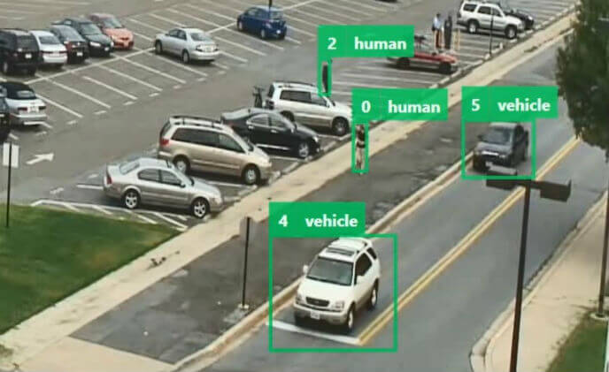
Video Analytics
Video and Image Analytics mostly revolve around the extraction of features from the image or video data. It can be a highly complex area of analytics especially if it has to be in real-time (see autonomous vehicles)
Involved in:
OCR (Optical Character Recognition)
Traffic Analysis
Security Monitoring

Slide 25

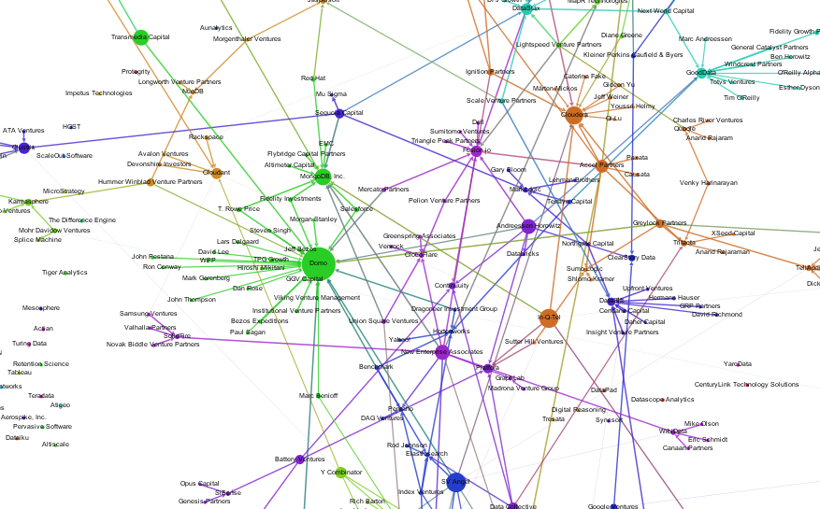
Graph Analytics
The study of interactions between entities is known as graph analytics or network analytics.
From the interactions between each entity, we are able to discover insights via cliques and gateway nodes.
Involved in:
Fraud Detection
Clustering
Entities-of-interest
Semantic Technologies
Linked online data
Network Analytics

Slide 26
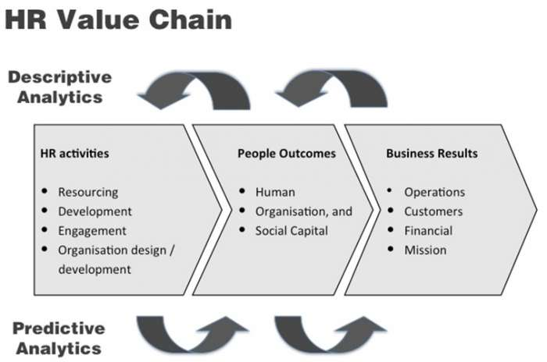
Human Resource Analytics
Human Resource creates a variety of data during the operation of the business. These datum can be in the form of exit surveys, employee feedback, claims, salaries, etc.
Involved in:
Workforce/Talent Profiling
Turnover Prediction
Performance Tracking
Skills Audit

Slide 27
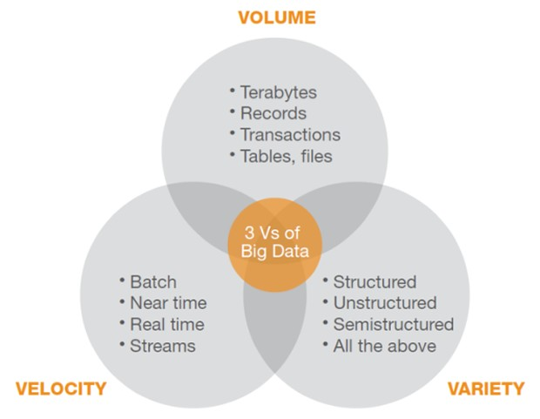
Big Data
Big Data is not just about Volume. It can be any or a combination of any of the 3 Vs. Most Big Data are transactional data.
Volume -> Size of data, quantity of data files
Velocity -> Amount of data to process per time unit
Variety -> How do I integrate many different sources of data

Slide 28
Data Analytics with Python
About Data

Slide 29
What is Data
Structured vs Unstructured Data:
Structured data is typically well organized e.g. data tables.
Unstructured data typically refers to text data where there is no well defined form e.g. images, videos, text documents
Raw vs Processed vs Summarized Data:
Raw data or processed data is preferable over summarized data, although some information may be lost after processing data.

Slide 30
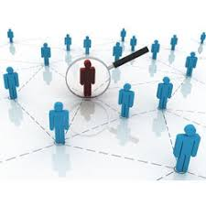

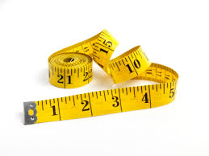
Different Types of Data
Identifiers:
Data fields that are used to uniquely identify entities of interest e.g. IC number, company registration number, purchase order number
Categorical:
Data fields that allow the data set to be grouped into categories. E.g. gender, occupation, department
Measures:
Data fields that hold numbers that quantify the value of an entity. E.g. Age, price, quantity

Slide 31
Tutorial
IPython Refresher
Identify different types of data

Slide 32
Data Analytics with Python
Descriptive, Diagnostic, Predictive

Slide 33
Outcomes from Analytics
Prediction Models
Statistics and Correlation
Business Intelligence

Slide 34
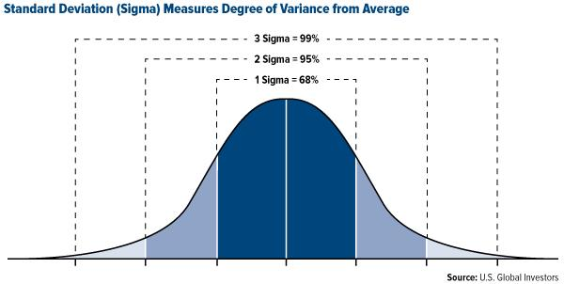
Descriptive Analytics
Descriptive Analytics is the examination of data or content, usually manually performed, to answer the question “What happened?” (or What is happening?), characterized by traditional business intelligence (BI) and visualizations such as pie charts, bar charts, line graphs, tables, or generated narratives.
What we do
Data Distribution
Data Visualization

Slide 35
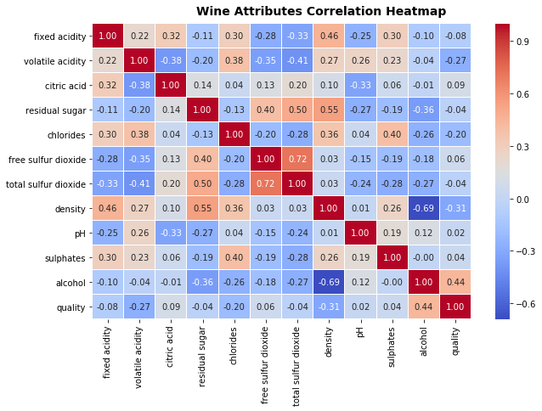
Diagnostics Analytics
Diagnostic Analytics examines data or content to answer the question “Why did it happen?”, and is characterized by techniques such as drill-down, data discovery, data mining and correlations.
What we do
Correlation
Covariance
Cointegration

Slide 36
Predictive Analytics
Predictive Analytics describe the use of statistics and modeling to determine future performance based on current and historical data. Predictive analytics look at patterns in data to determine if those patterns are likely to emerge again, which allows businesses and investors to adjust where they use their resources in order to take advantage of possible future events.
What we do
Linear Regression
Classification

Slide 37
Hands-on
Examine Data Distribution of dataset
Anomaly detection
Charting with pandas and matplotlib
Correlation Study
Modeling

Slide 38
Data Analytics with Python
APPENDIX

Slide 39
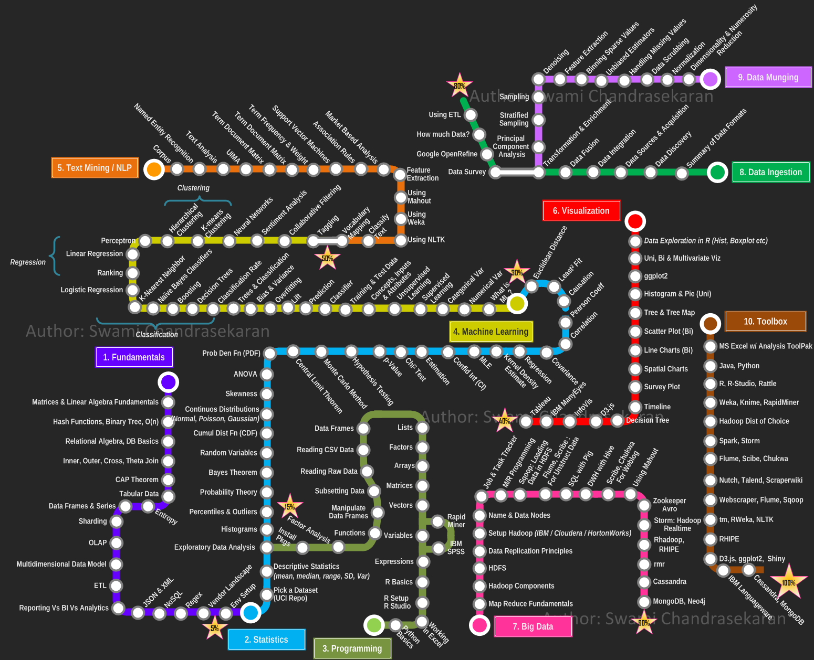
Analytics Roadmap
http://nirvacana.com/thoughts/2013/07/08/becoming-a-data-scientist/

Slide 40
Community
Extra Resources:
http://pugs.org.sg/pages/learning.html
Local Community:
Python User Group (Singapore) http://pugs.org.sg
PyData-SG https://www.facebook.com/groups/pydatasg/
PyLadies-SG https://www.facebook.com/PyLadiesSG/
Events:
PyCon Singapore – usually held in June/July

Slide 41
Data Analytics with Python
Trainer: Michael Li
Venue: NTUC Learning Hub
Date Conducted: 23 Oct 2018

